Slide 1
Detection of Microplastics in Water
TEAM NAME : THE SPARK
TEAM MEMBERS:
1.SIBITHRA V – 24UEC240
2.VIVIKSHA K – 24UEC262
3.SAKTHIVEL V – 24UEC226
4.ARUN R – 24UEC115
5.SHRIKRISHNAMOORTHY s – 24UEC239

Slide 2
ABSTRACT
Microplastics, defined as plastic particles smaller than 5 mm, have become a major threat to freshwater and drinking water systems. They originate from the breakdown of single-use plastics, industrial discharge, synthetic fibers, and fishing gear. Conventional treatment plants cannot effectively remove them, allowing microplastics to reach household taps. These particles may carry harmful chemicals and pathogens, posing risks such as endocrine disruption, inflammation, and long-term bioaccumulation in humans. This project focuses on identifying the causes, impacts, and potential solutions for microplastic contamination in water supplies. A low-cost embedded optical detection system is proposed as a practical approach for real-time monitoring and safeguarding public health.

Slide 3
Detailed Background
Plastic pollution is one of the most pressing environmental challenges of the 21st century. With increasing global plastic production, millions of tons of waste end up in rivers, lakes, and oceans. Under UV light, temperature changes, and mechanical stress, large plastics break down into smaller fragments called microplastics.
These particles are ingested by aquatic organisms, disrupting ecosystems.
Wastewater treatment plants are not fully capable of filtering them out.
Microplastics have even been detected in bottled water, household tap water, and table salt.
Thus, microplastic contamination has become both an environmental and human health problem, making it urgent to design low-cost detection and mitigation strategies.

Slide 4
Problem Definition
The increasing presence of microplastics in water sources and drinking supplies poses serious risks to health and the environment. Despite advances in water treatment, no cost-effective and efficient system currently exists to detect and quantify microplastics in real time. This lack of monitoring threatens water safety and weakens public trust.

Slide 5
Why This Problem Was Chosen
It is a global and local concern, directly linked to human health.
Existing solutions are expensive and not suitable for developing countries.
The project offers scope for practical embedded system applications in environmental monitoring.
It aligns with Sustainable Development Goal 6 (Clean Water and Sanitation).

Slide 6
Solution for the Problem
This embedded detection system using:
Laser + photodiode setup to measure light scattering by microplastics.
LM358-based transimpedance amplifier for signal processing.
ESP32 microcontroller for data acquisition and threshold analysis.
OLED display to show water quality in real time.
The system will allow quick detection of microplastics in household or community water supplies and can be scaled for larger use. In the long run, coupling with filtration methods (activated carbon, membrane filters) can enhance safety.

Slide 7
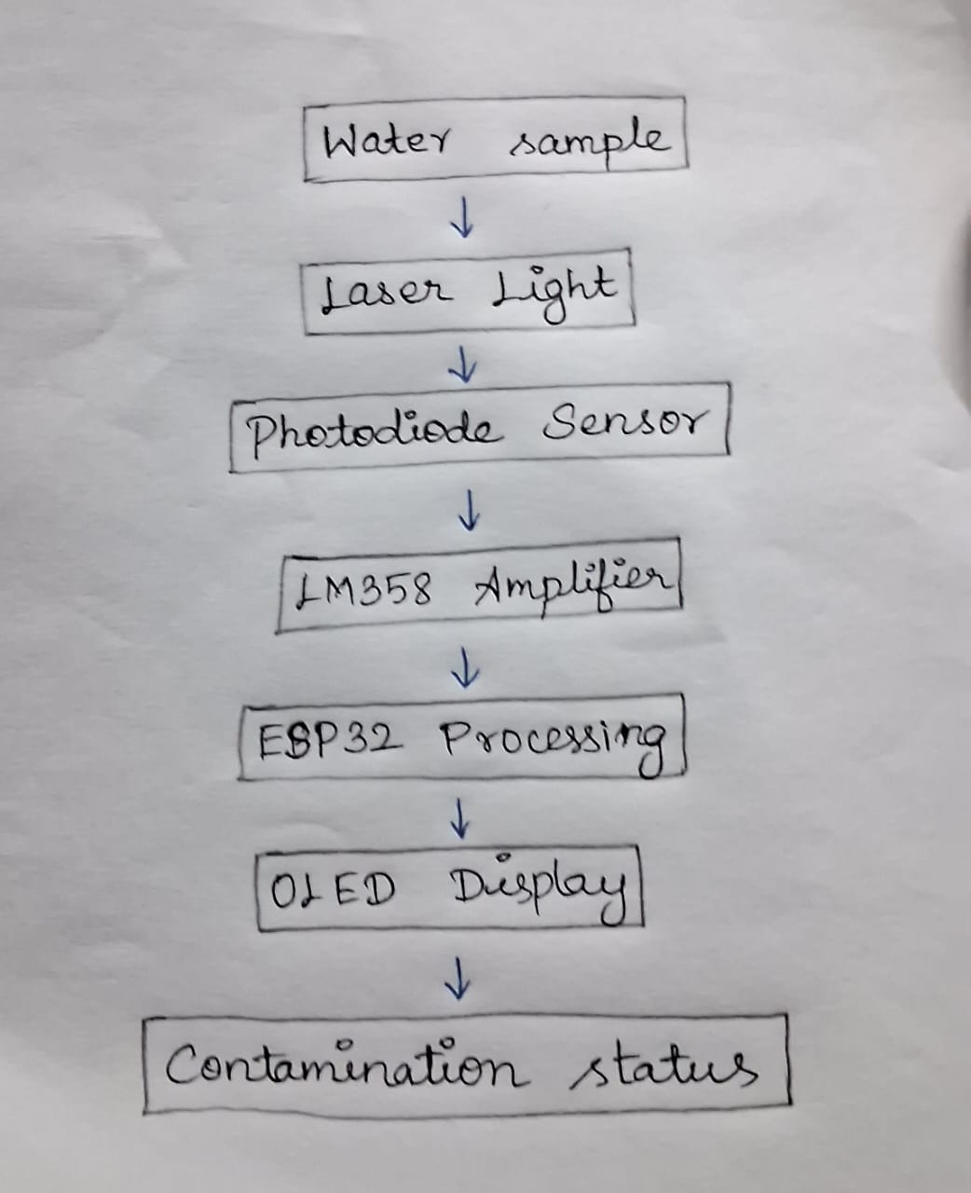
FLOWCHART

